Slide 1
LIVING IN NOTTINGHAM
A green city with a legendary past, a vibrant culture and a bright future.
A creative city of rebels and pioneers, and the home of Robin Hood.

Slide 2
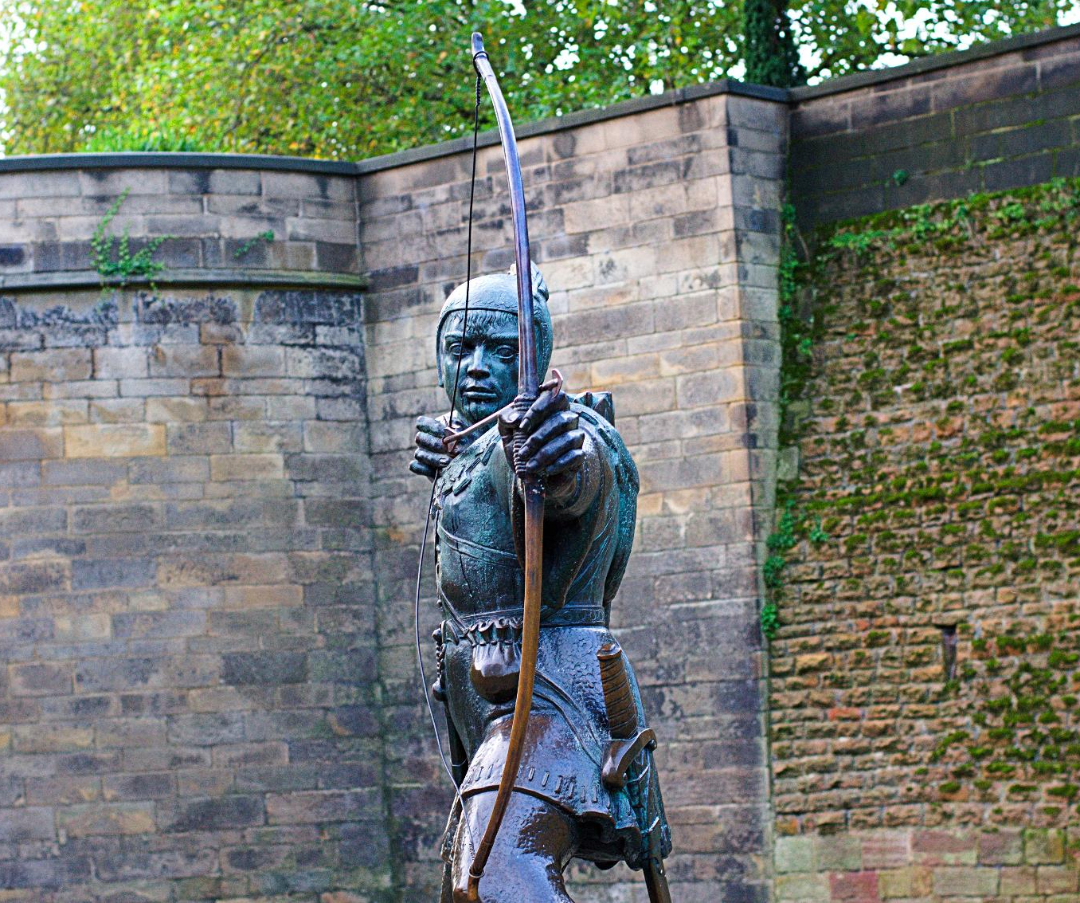
NOTTINGHAM
NOTTINGHAM is the BIGGEST SMALL CITY IN THE UK – a city FOR EVERYONE, where the SPIRIT OF ROBIN HOOD and his sense of FAIRNESS and INCLUSIVITY live on.
NOTTINGHAM
Nottingham Council House

Slide 3
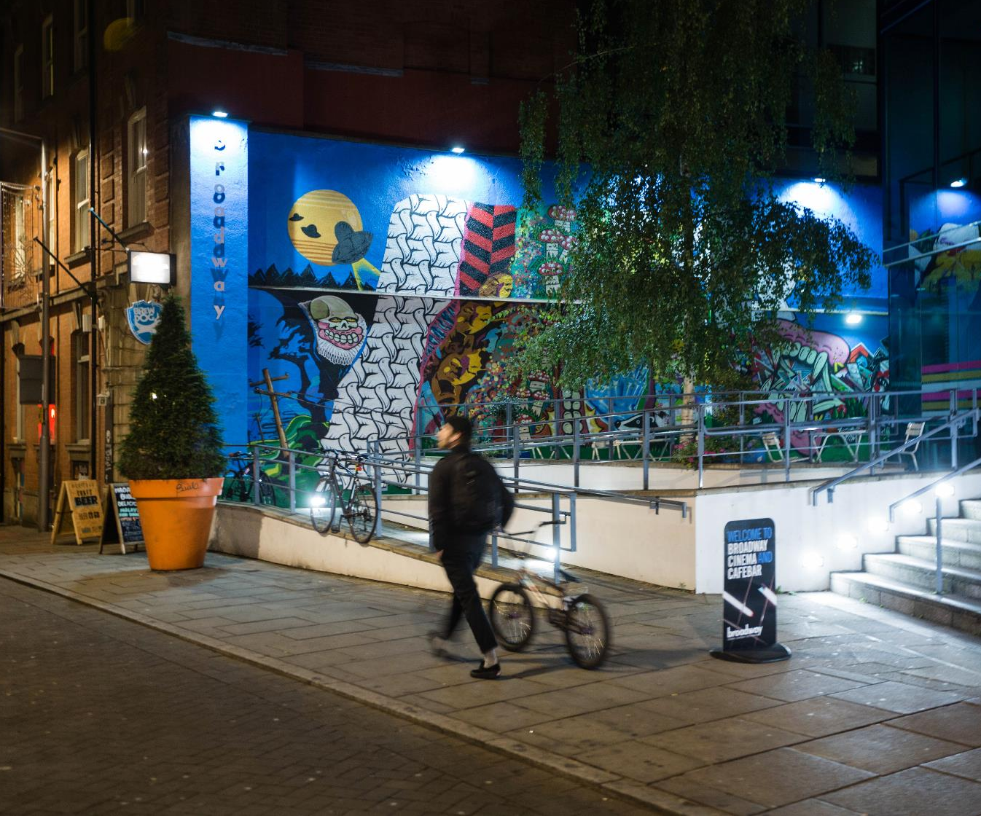
NOTTINGHAM
A place where you can raise a FAMILY and make new FRIENDS, to LIVE, WORK and STUDY, to follow your HEART and chase your DREAMS, all within a rich tapestry of HISTORY and HERITAGE, beautiful ARCHITECTURE, CULTURE and CREATIVITY.
NOTTINGHAM
Robin Hood Statue

Slide 4
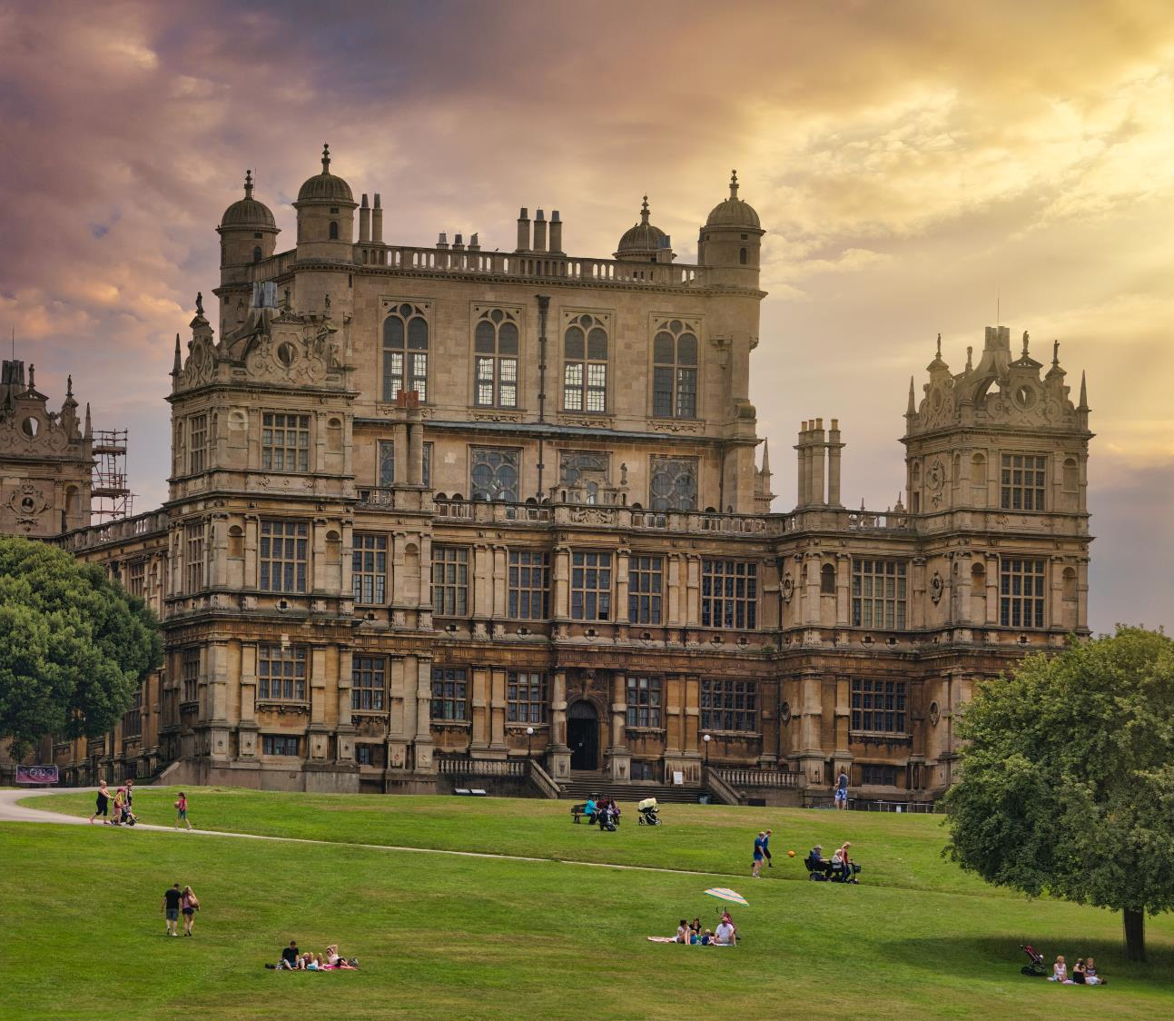
NOTTINGHAM
A place with GREEN spaces and HERITAGE sites which INSPIRE literature and film, from the Arboretum to Wollaton Hall.
NOTTINGHAM
Wollaton Hall

Slide 5
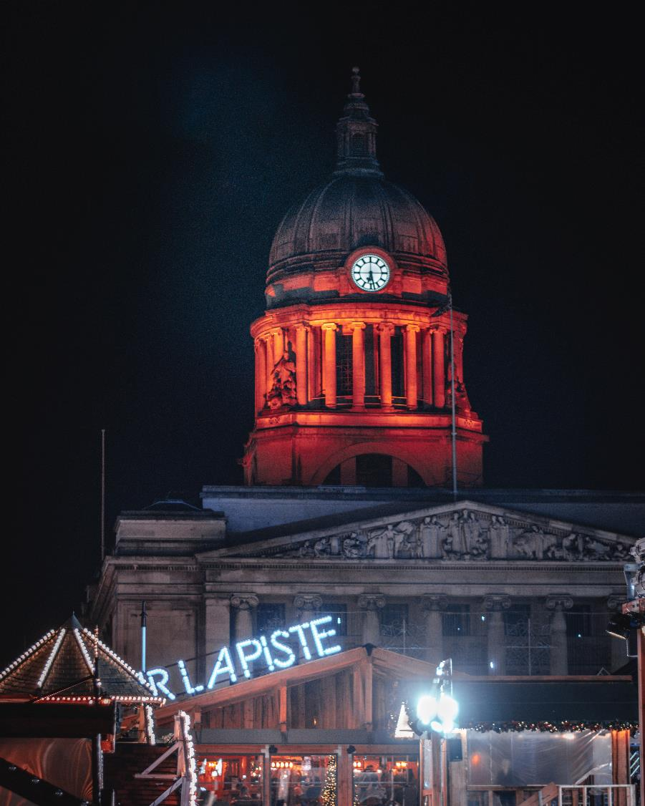
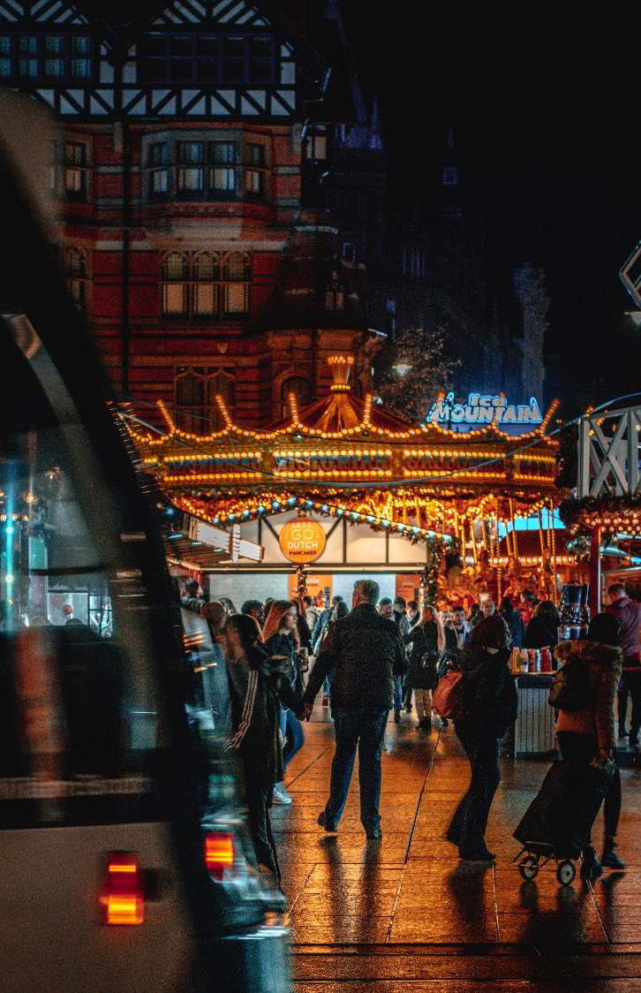
NOTTINGHAM
A place that’s home to one of Europe’s largest city squares, which comes to life with VIBRANT and COLOURFUL events for every season – presided over by its MAGNIFICENT Council House and under the watchful gaze of its iconic lions.
NOTTINGHAM

Slide 6
NOTTINGHAM
An INTERNATIONAL city which welcomes people from all over the world to LIVE and STUDY, and where everyone can experience its DIVERSE cultural offer, from LIVELY festivals to world food.
NOTTINGHAM
Broadway, Lace Market

Slide 7
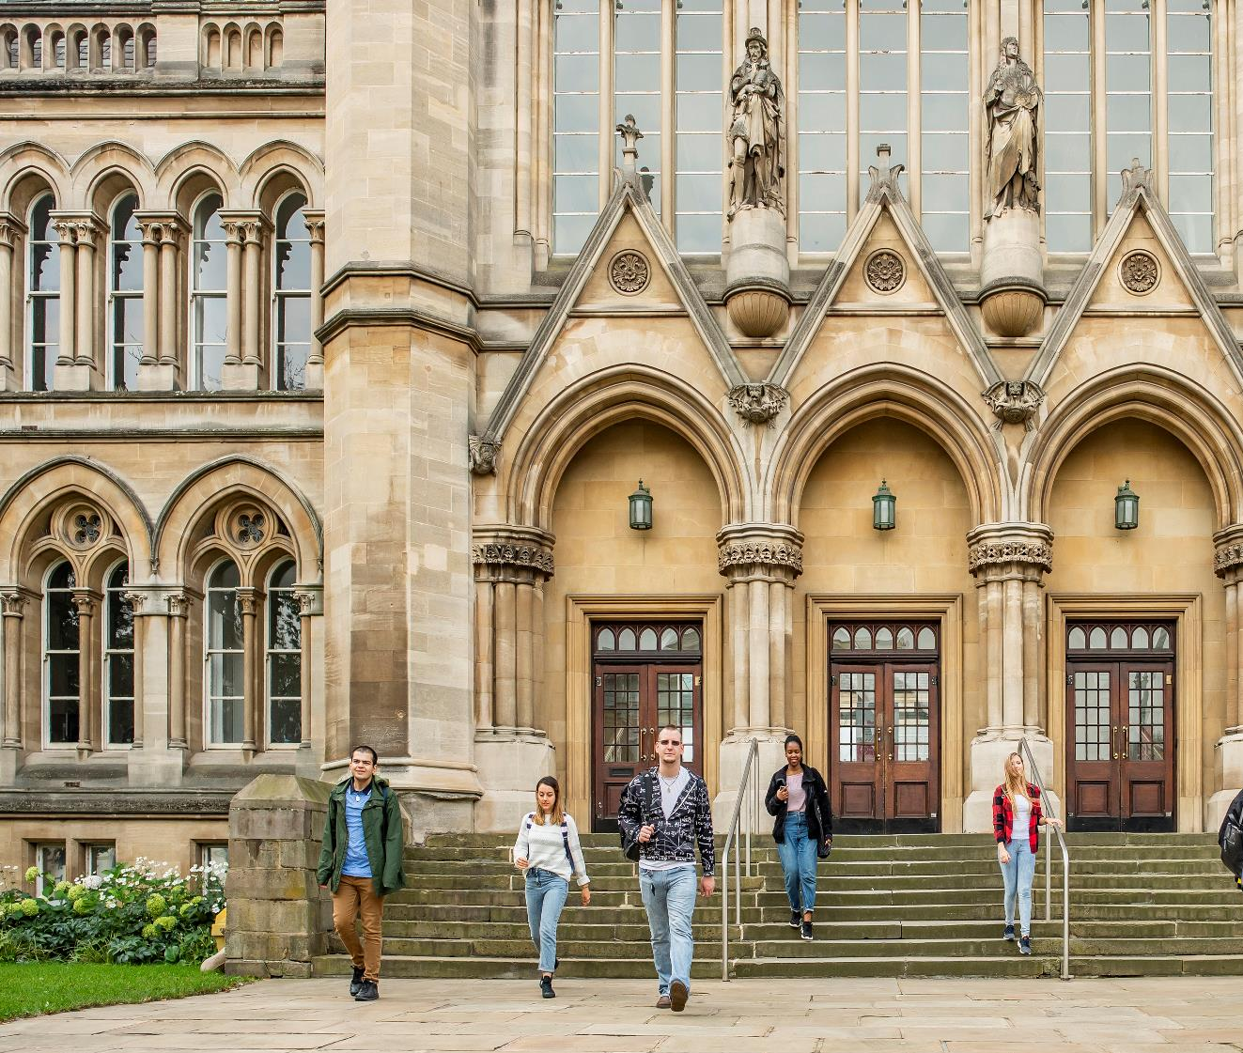
NOTTINGHAM
A city with a LEGENDARY sports heritage and WORLD-CLASS sports stadiums on the banks of the RIVER TRENT.
NOTTINGHAM
Arkwright Building
Nottingham Trent University

Slide 8
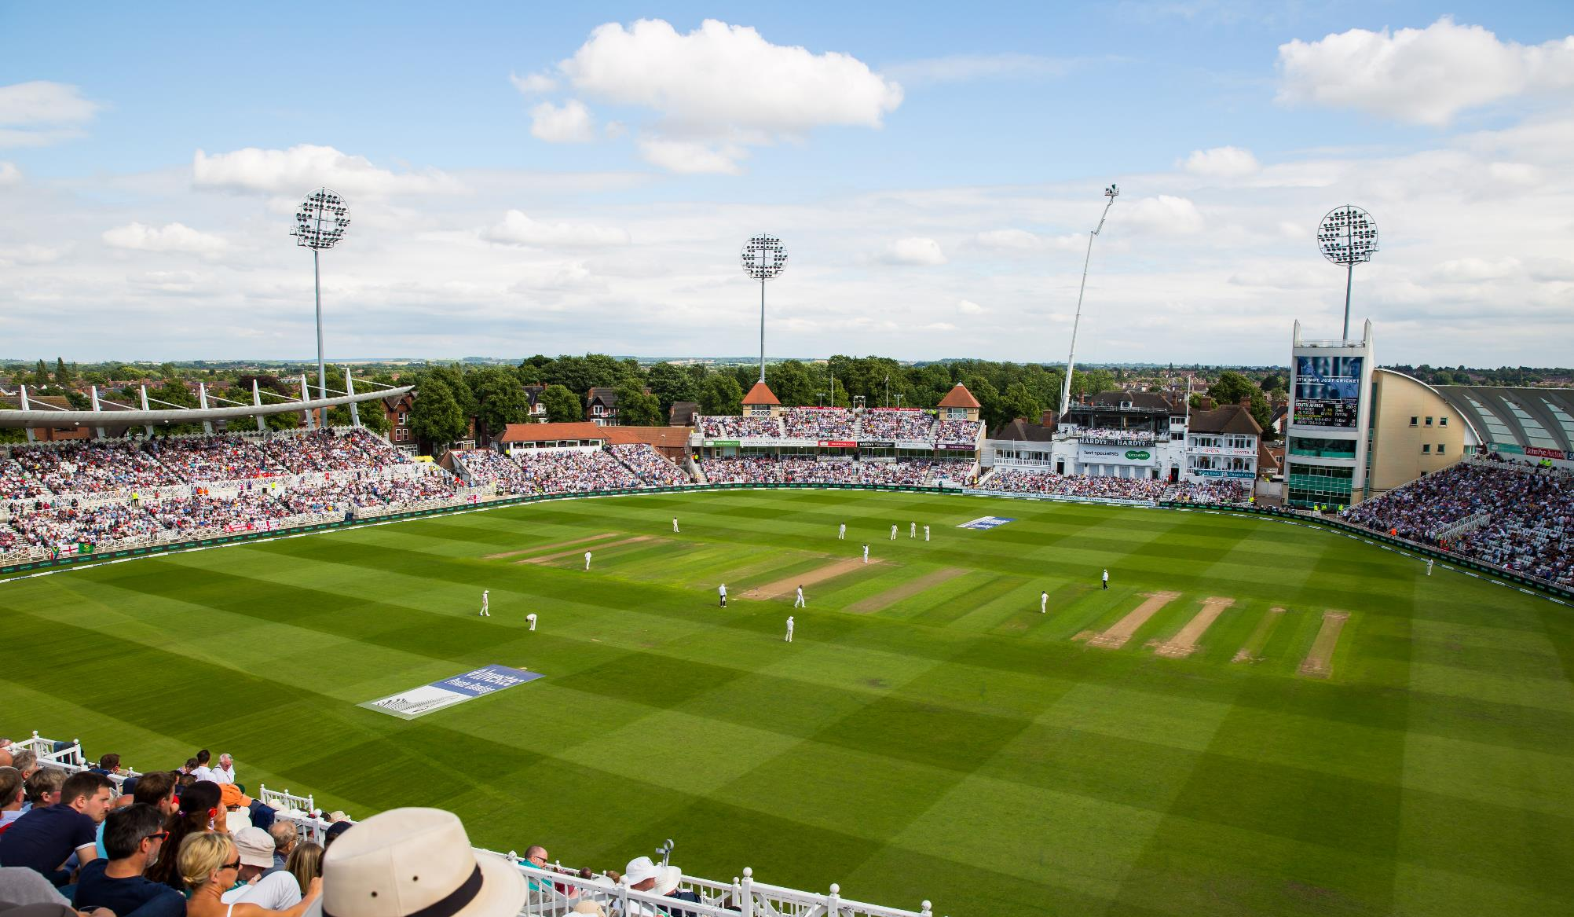
A city with a LEGENDARY sports heritage and WORLD-CLASS sports stadiums on the banks of the RIVER TRENT.
NOTTINGHAM
Trent Bridge Cricket Ground

Slide 9
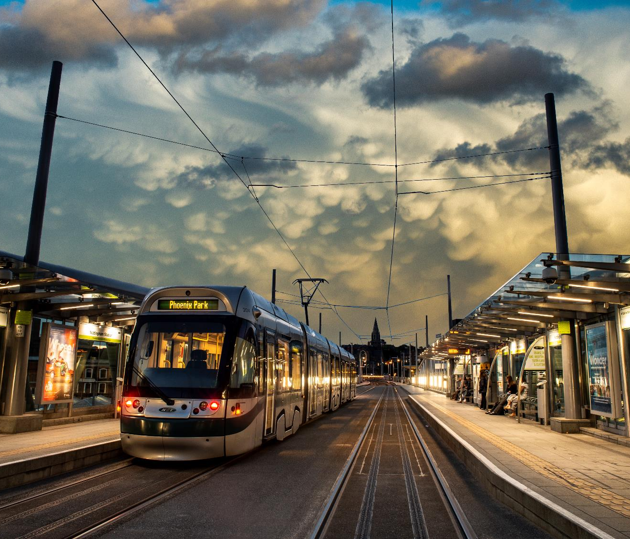
NOTTINGHAM
A place that’s WELL CONNECTED to the rest of the UK and offers a WORLD-CLASS PUBLIC TRANSPORT system.
NOTTINGHAM
Nottingham’s award-winning tram system
Credit: Mike Beard

Slide 10
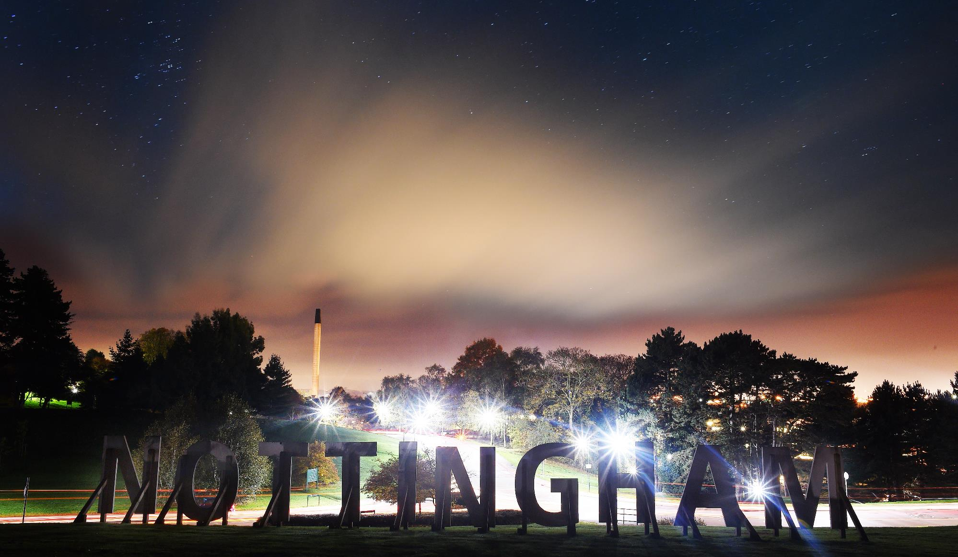
Where INNOVATION and INVESTMENT are driving the city forward and award-winning green housing schemes make our homes warmer and more energy efficient. A PLACE YOU FEEL PROUD TO CALL HOME.
NOTTINGHAM
NOTTINGHAM

Slide 11
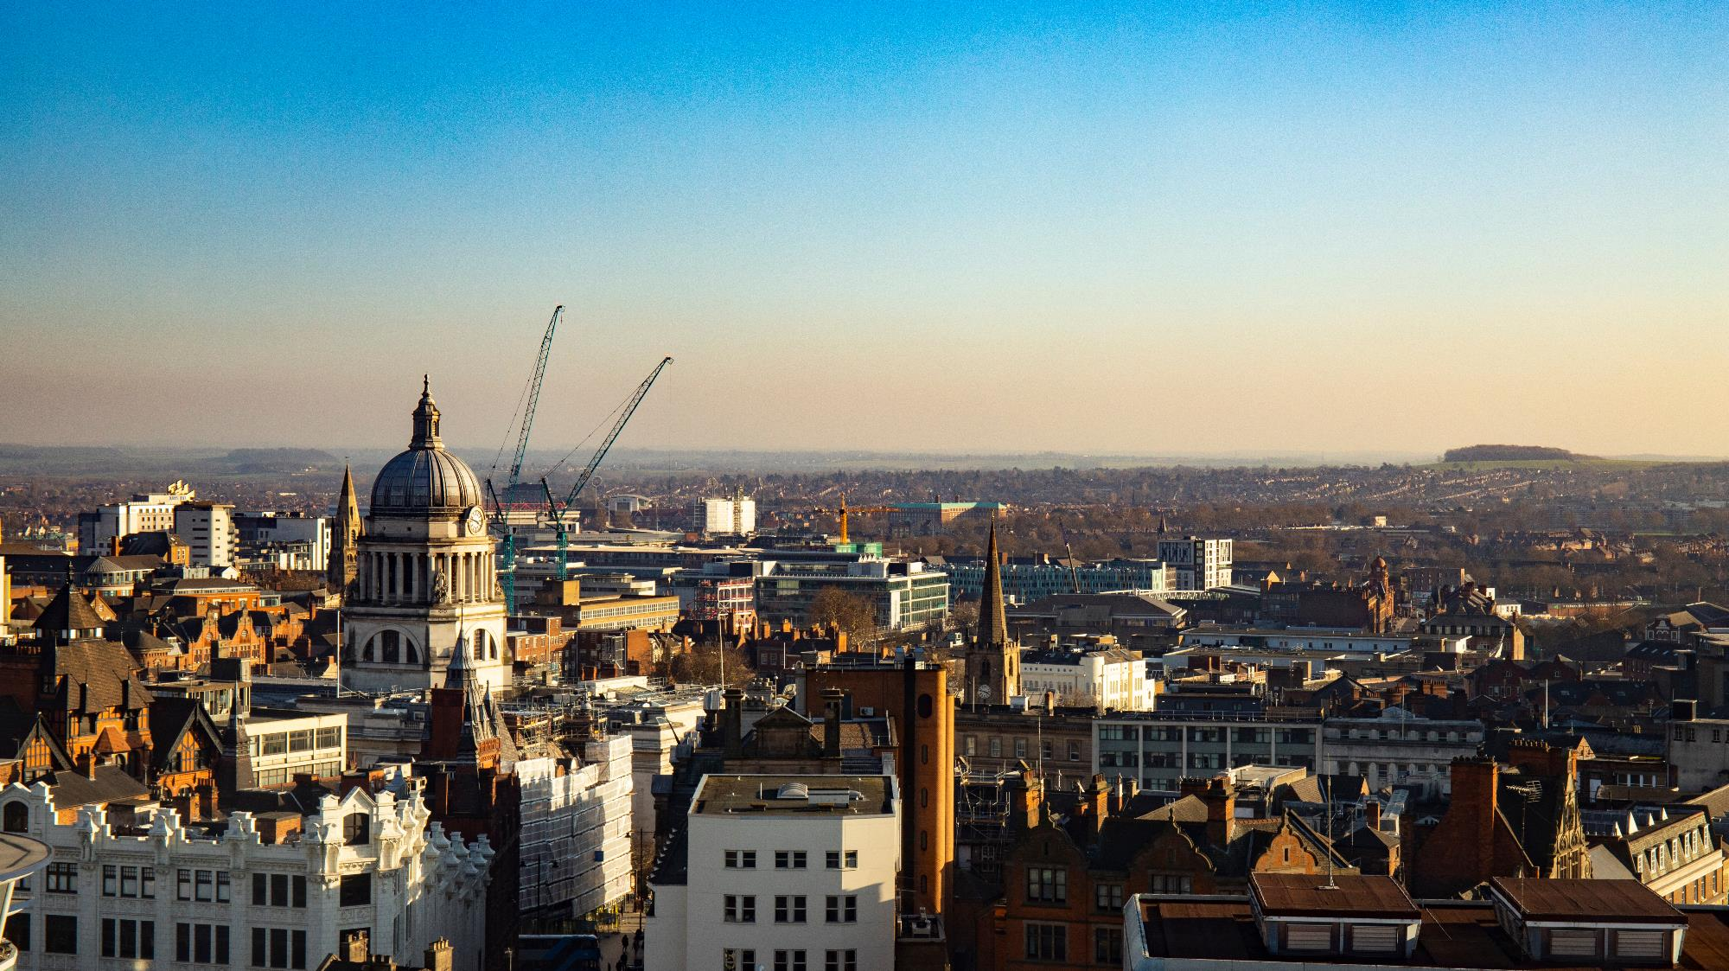
CONTACT US AT:
ENQUIRIES@INVESTINNOTTINGHAM.CO.UK

