Slide 1

WELCOME
WELCOME TO NOTTINGHAM
A green city with a legendary past, a vibrant culture and a bright future.
A creative city of rebels and pioneers, and the home of Robin Hood.

Slide 2
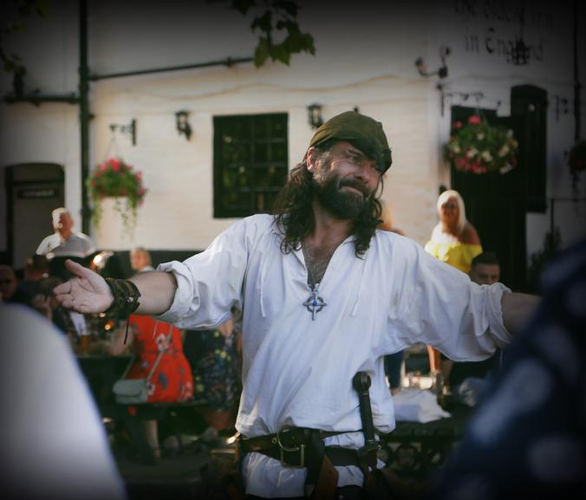
WELCOME
NOTTINGHAM is a city that’s full of SURPRISES,
A city where you can follow in the footsteps of
ROBIN HOOD.
WELCOME
Robin Hood Town Tour by Ezekial Bone

Slide 3
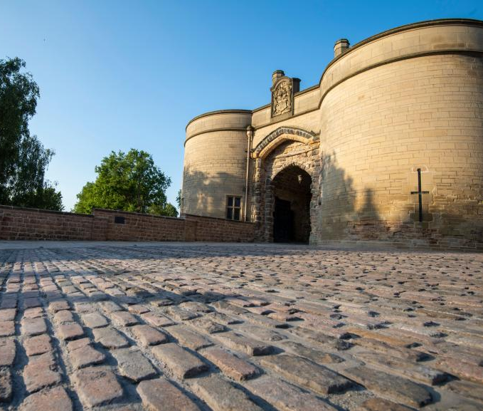
WELCOME
A place where UNDERGROUND CAVES lie hidden beneath the city streets, where you can experience a THOUSAND YEARS OF HISTORY at Nottingham Castle and stop for a drink in the OLDEST INN IN ENGLAND.
WELCOME
Nottingham Castle

Slide 4

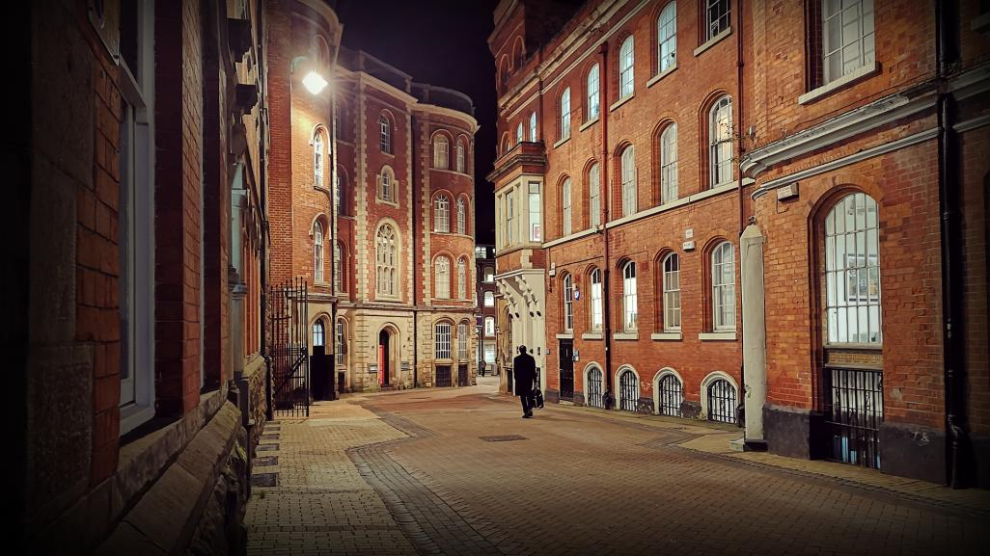
WELCOME
A CITY THAT’S EASY TO EXPLORE ON FOOT,
WHERE YOU’LL STUMBLE ACROSS SECRET BARS, INDEPENDENT SHOPS AND WATSON FOTHERGILL ARCHITECTURAL TREASURES
AMONGST THE CURIOUS ALLEYWAYS, BOUTIQUE ARCADES AND REDBRICK MILLS.
WELCOME

Slide 5
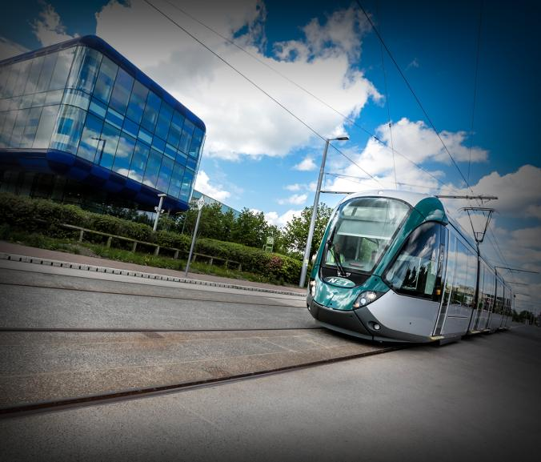
WELCOME
As one of the UK’s MOST SUSTAINABLE CITIES, you can hop on and off the AWARD-WINNING CLEAN AND GREEN public transport network and breathe in the CLEANEST CITY AIR.
WELCOME
Nottingham’s award-winning tram system

Slide 6
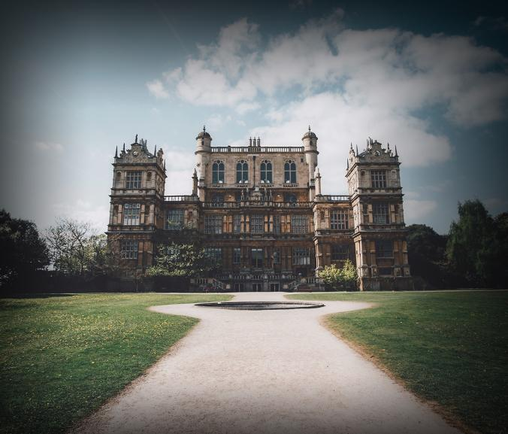
WELCOME
Or stroll around its STUNNING PARKS and GREEN SPACES, from the LEGENDARY SHERWOOD FOREST to the magnificent WOLLATON PARK to the enchanting ARBORETUM.
WELCOME
Wollaton Hall

Slide 7

WELCOME
TASTE CUISINES FROM AROUND THE WORLD, ALL IN THE HEART OF ENGLAND.
WELCOME

Slide 8
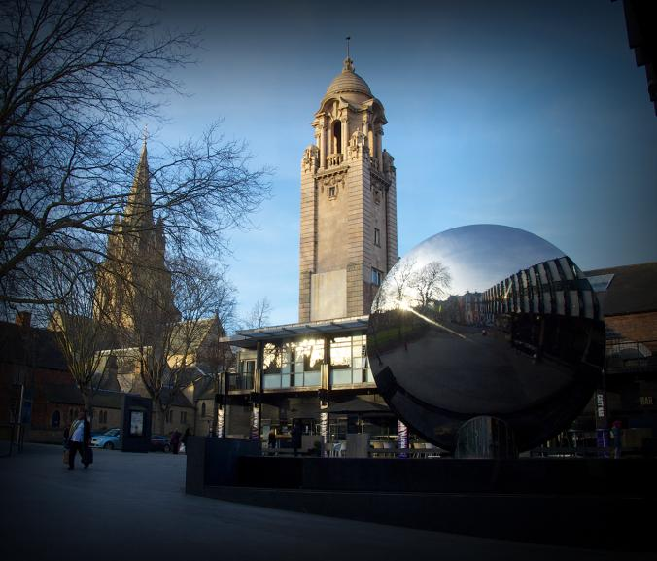
WELCOME
A CITY OF CULTURE and creativity with a VIBRANT MUSIC AND ARTS Scene, from the UK’s best regional theatre to the INTERNATIONALLY-ACCLAIMED Nottingham Contemporary.
WELCOME
Nottingham Playhouse

Slide 9
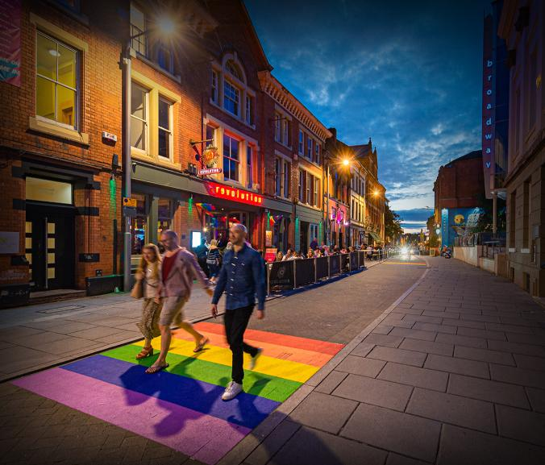
WELCOME
A city with WORLD-CLASS SPORTS and a remarkable sporting heritage.
A city that’s buzzing with life, with new experiences around every corner – and it’s waiting to be discovered.
WELCOME
© Lamar Francois – www.picturedbylamar.co.uk

Slide 10
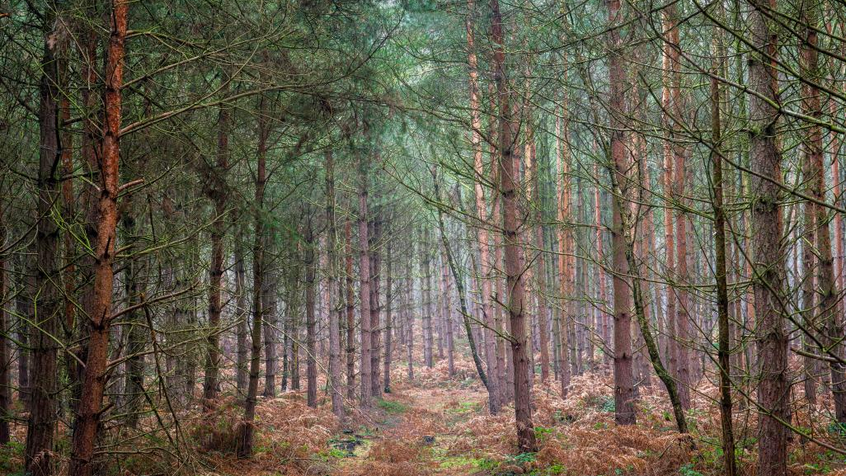
CONTACT US AT:
MARKETING @MARKETINGNOTTINGHAM.UK

