Slide 1
WHY NOTTINGHAM
A green city with a legendary past, a vibrant culture and a bright future.
A creative city of rebels and pioneers, and the home of Robin Hood.

Slide 2
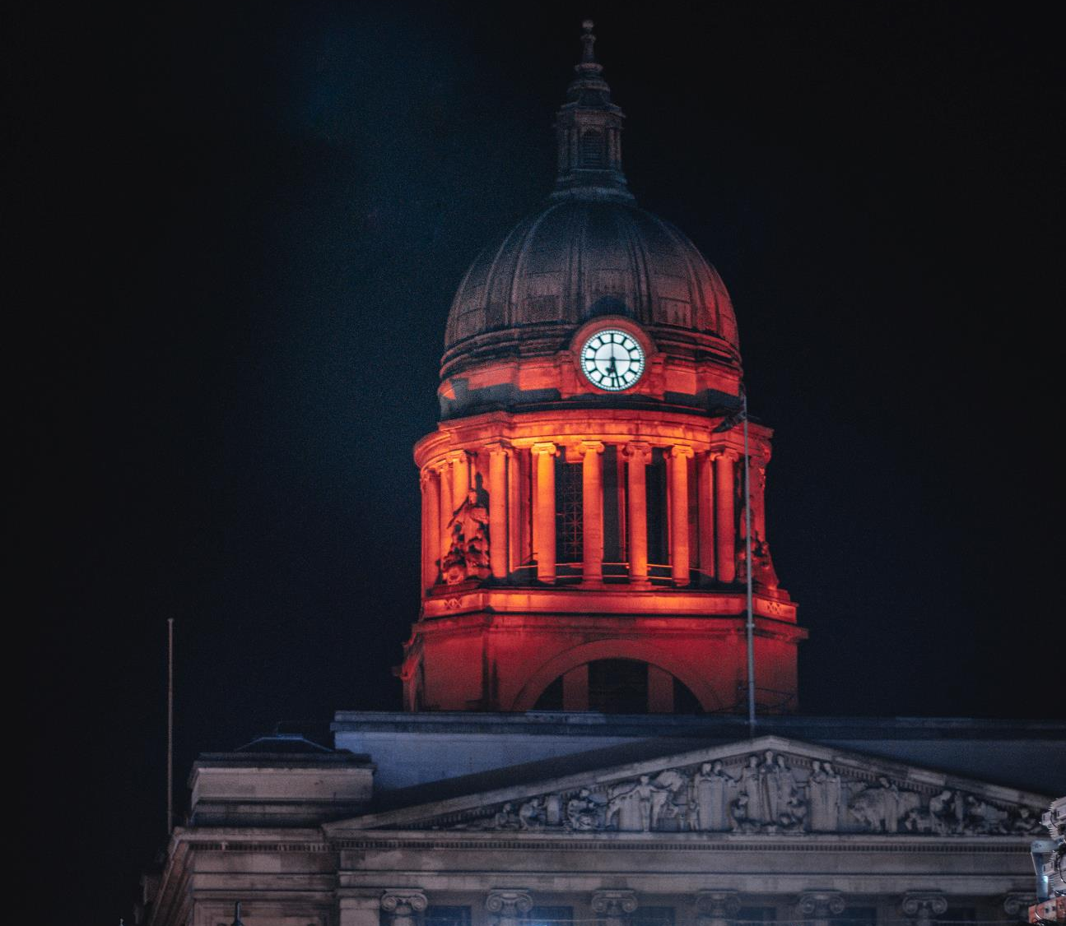
NOTTINGHAM
NOTTINGHAM is a city with a RICH PAST and a BRIGHT FUTURE.
NOTTINGHAM
Nottingham Council House

Slide 3
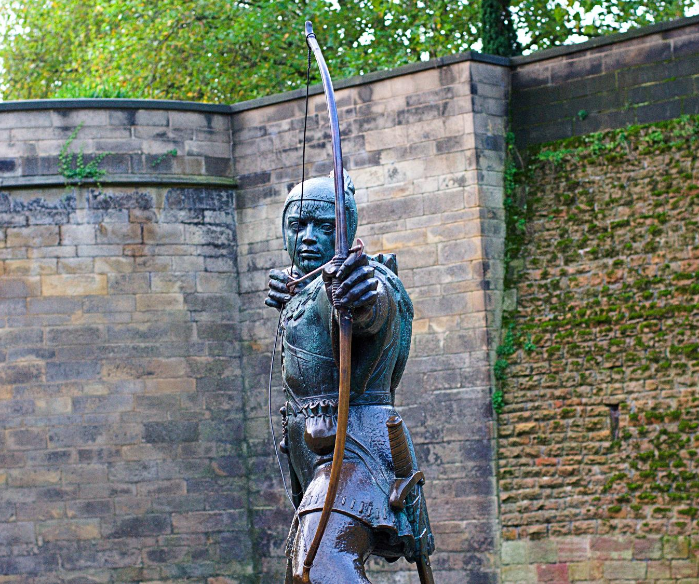
NOTTINGHAM
A city of LEADERS and LEGACY, known for its RESILIENCE, its COMPASSION and its COMMUNITY SPIRIT – just like its hero, ROBIN HOOD.
NOTTINGHAM
Robin Hood Statue

Slide 4
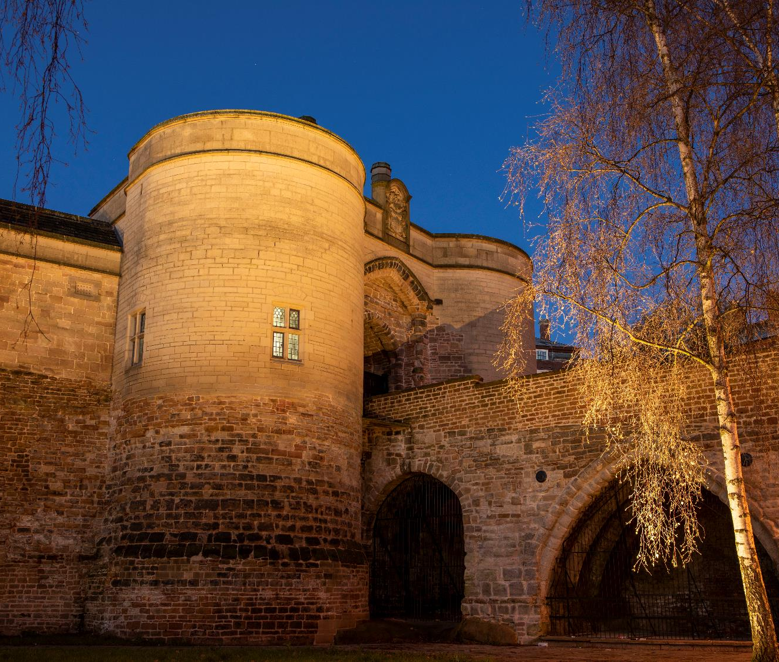
NOTTINGHAM
A city where you’ll find the LEGEND of its OUTLAW HERO and A THOUSAND YEARS OF HISTORY at Nottingham Castle a stone’s throw from STATE-OF-THE-ART developments emerging in Southside, Waterside and the
Island Quarter.
NOTTINGHAM
Nottingham Castle
Credit: Tracey Whitefoot and Nottingham Castle Trust
Wollaton Hall

Slide 5
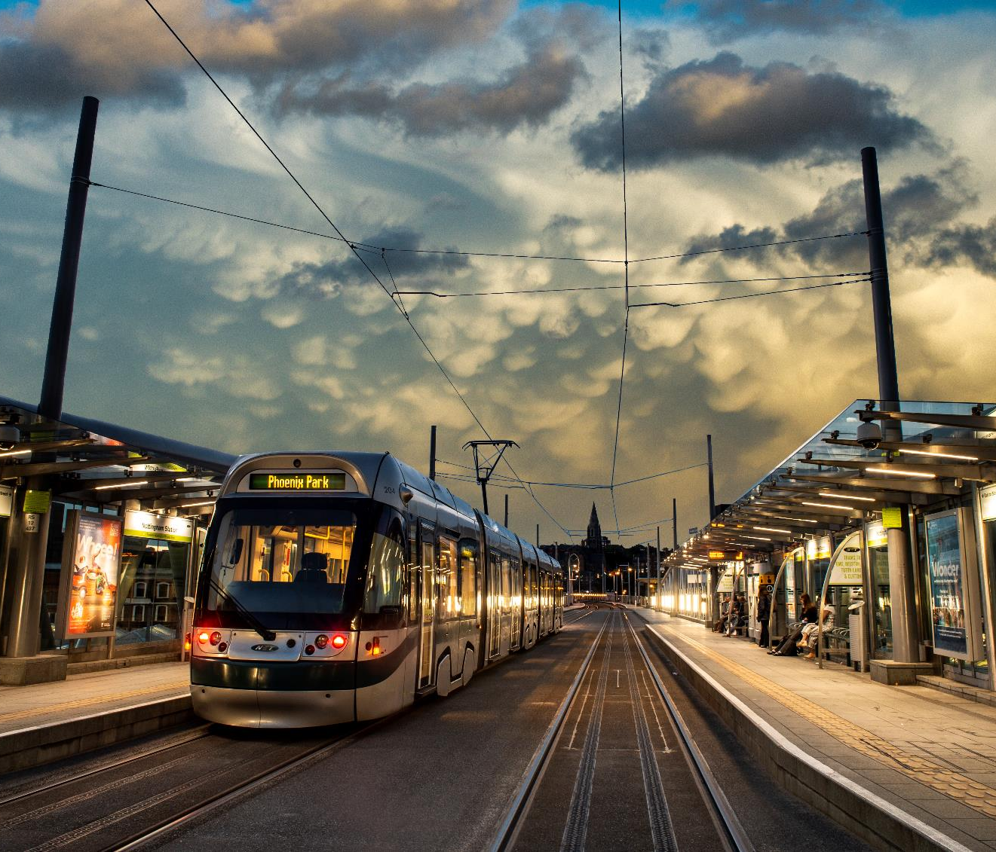
Boots Nottingham
Credit Marketing Nottingham
NOTTINGHAM
A place that’s on a mission to become the UK’S FIRST CARBON-NEUTRAL CITY by 2028, with unprecedented levels of investment in an AWARD-WINNING, CLEAN and GREEN public transport system, electric vehicles and sustainable energy sources.
NOTTINGHAM
Nottingham’s award-winning tram system
Credit: Mike Beard

Slide 6
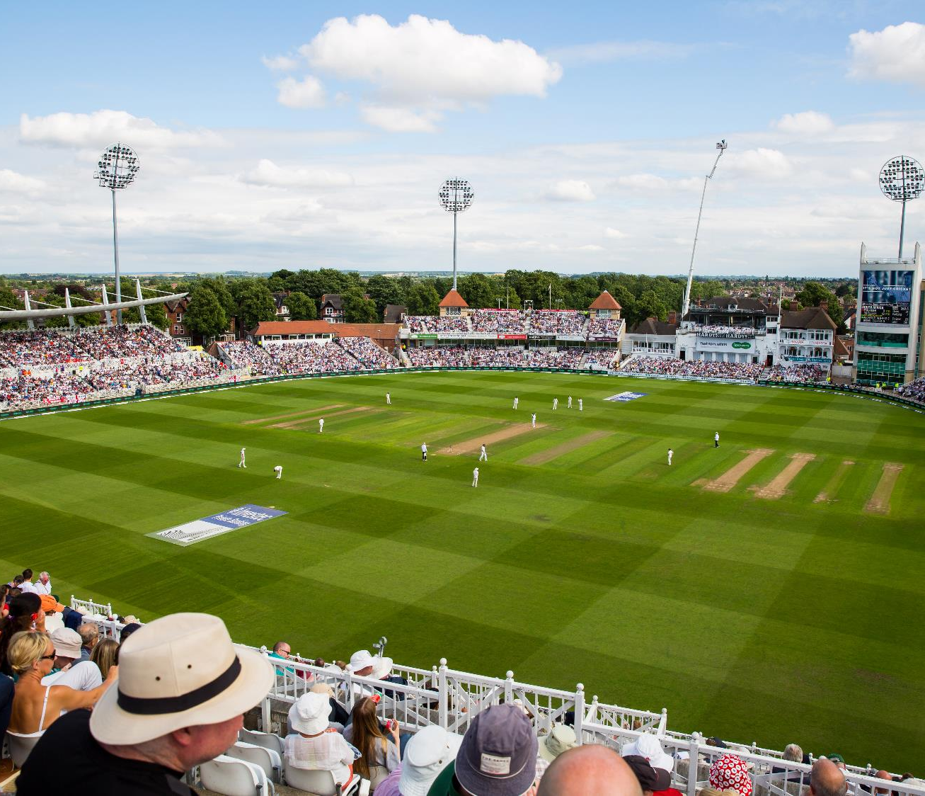
Trent Bridge Cricket Ground
NOTTINGHAM
A vibrant clash of CREATIVITY and CULTURE, HISTORY and HERITAGE, and WORLD-CLASS SPORTS.
NOTTINGHAM
Broadway, Lace Market

Slide 7
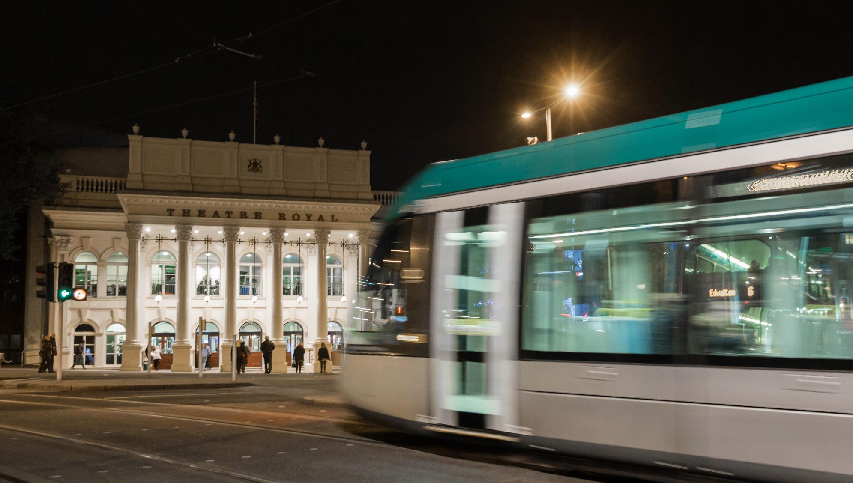
And you’ll find INDEPENDENT shops, WORLD CUISINE and a thriving NIGHTLIFE buzzing within the curious alleyways, boutique arcades and beautiful ARCHITECTURE.
NOTTINGHAM
NOTTINGHAM

Slide 8
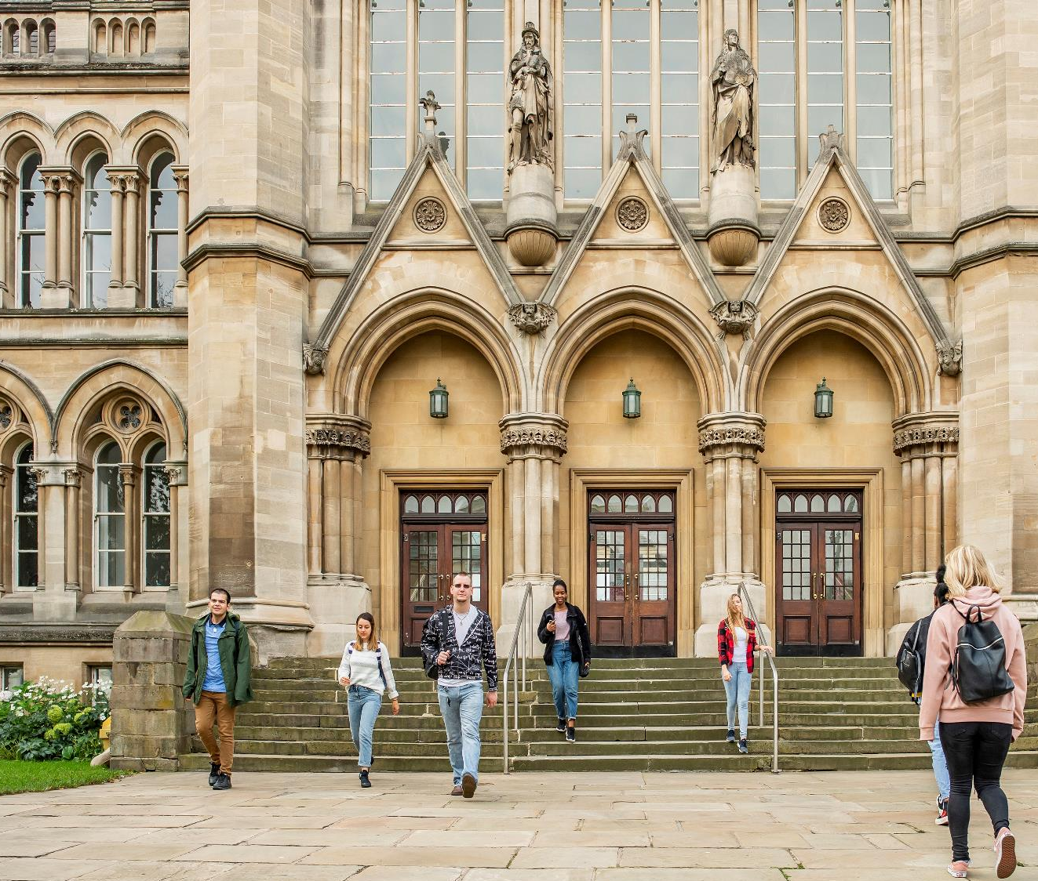
NOTTINGHAM
And two WORLD-CLASS universities nurturing INNOVATION and INDEPENDENT minds, while a GROWING business scene secures their future.
NOTTINGHAM
Arkwright Building
Nottingham Trent University

Slide 9
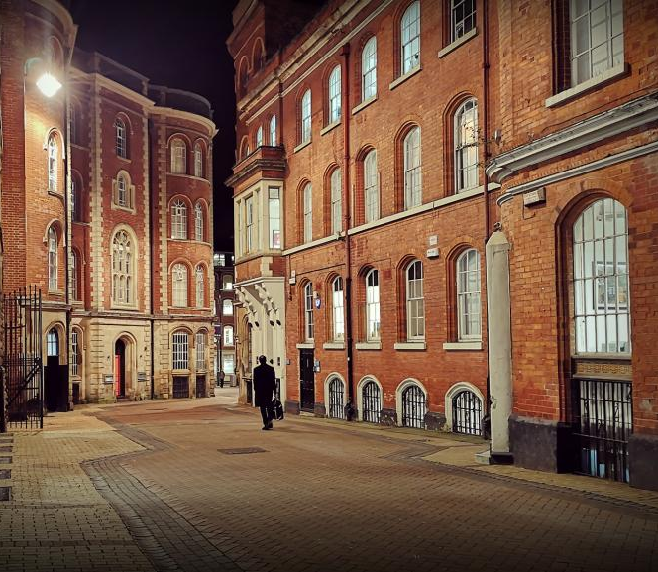
NOTTINGHAM
A place that’s always MOVING FORWARD while CELEBRATING ITS PAST.
NOTTINGHAM
Nottingham’s award-winning tram system

Slide 10
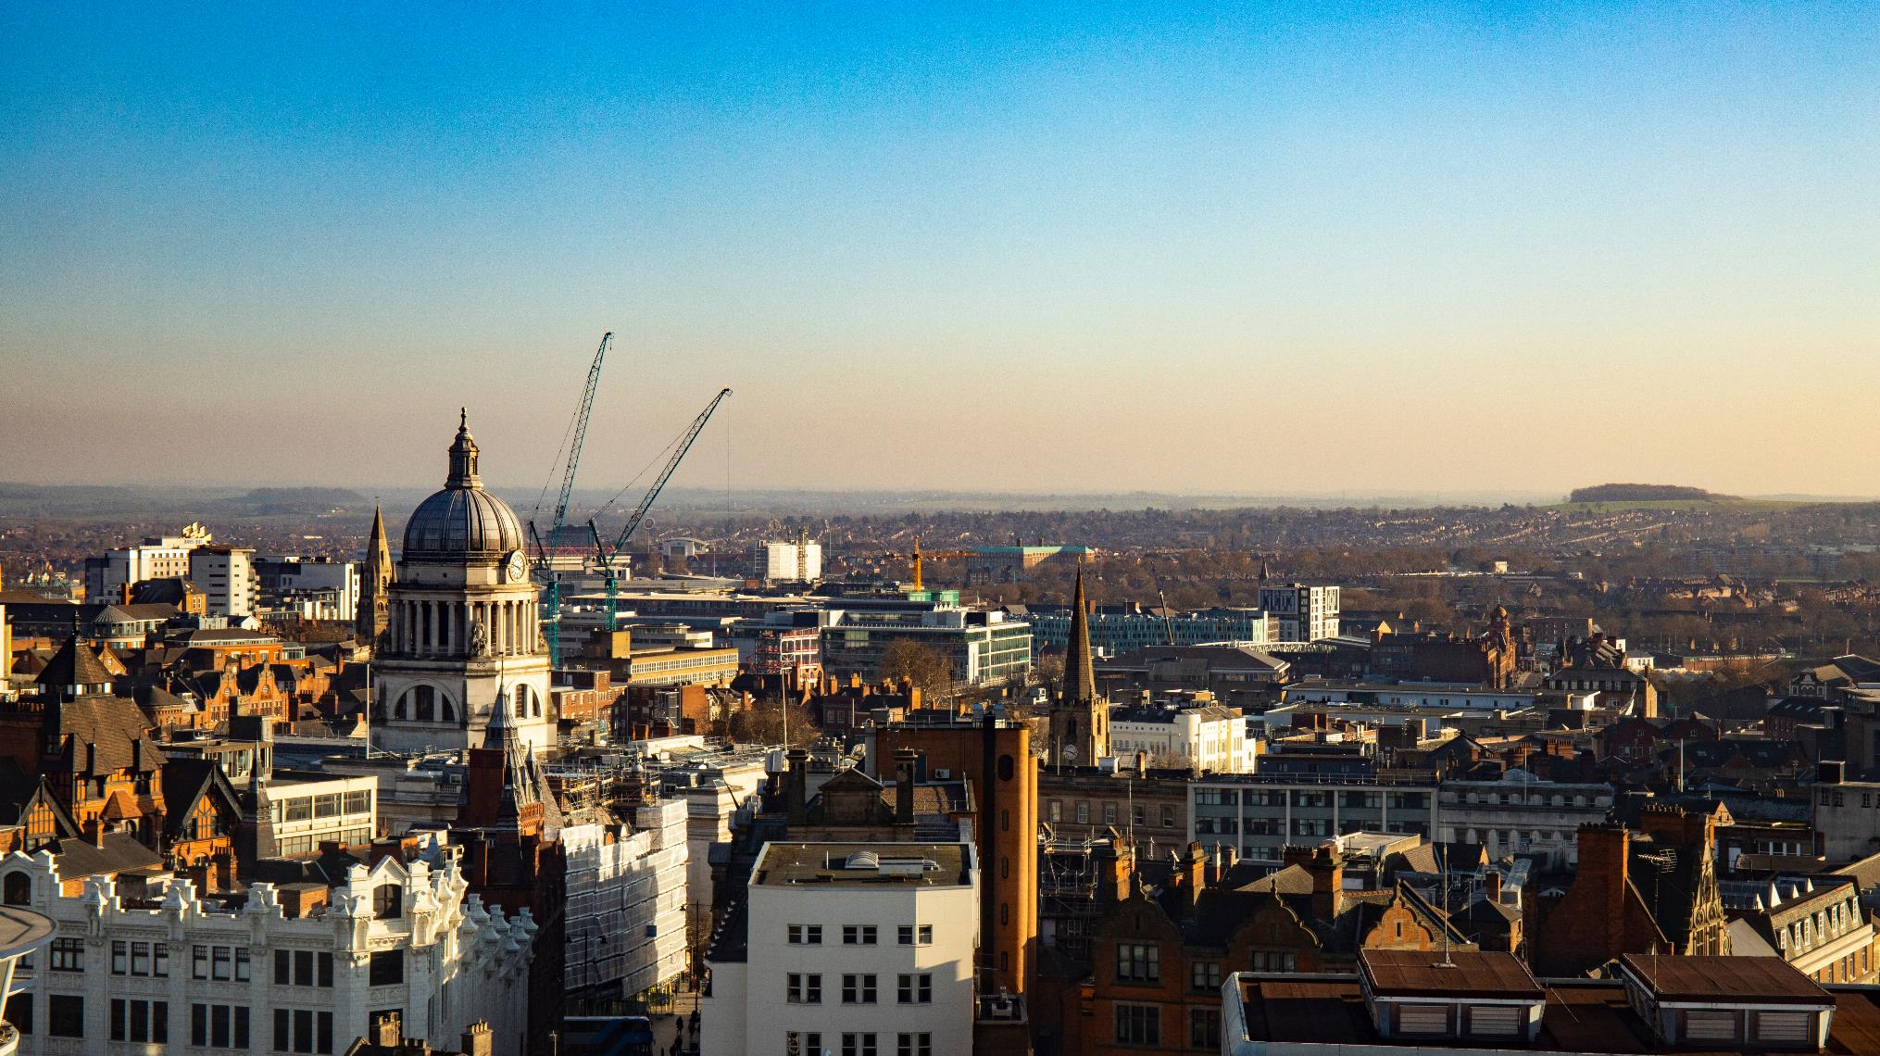
The BIGGEST SMALL CITY in the UK, nestled in the HEART OF THE MIDLANDS.
NOTTINGHAM
NOTTINGHAM

Slide 11
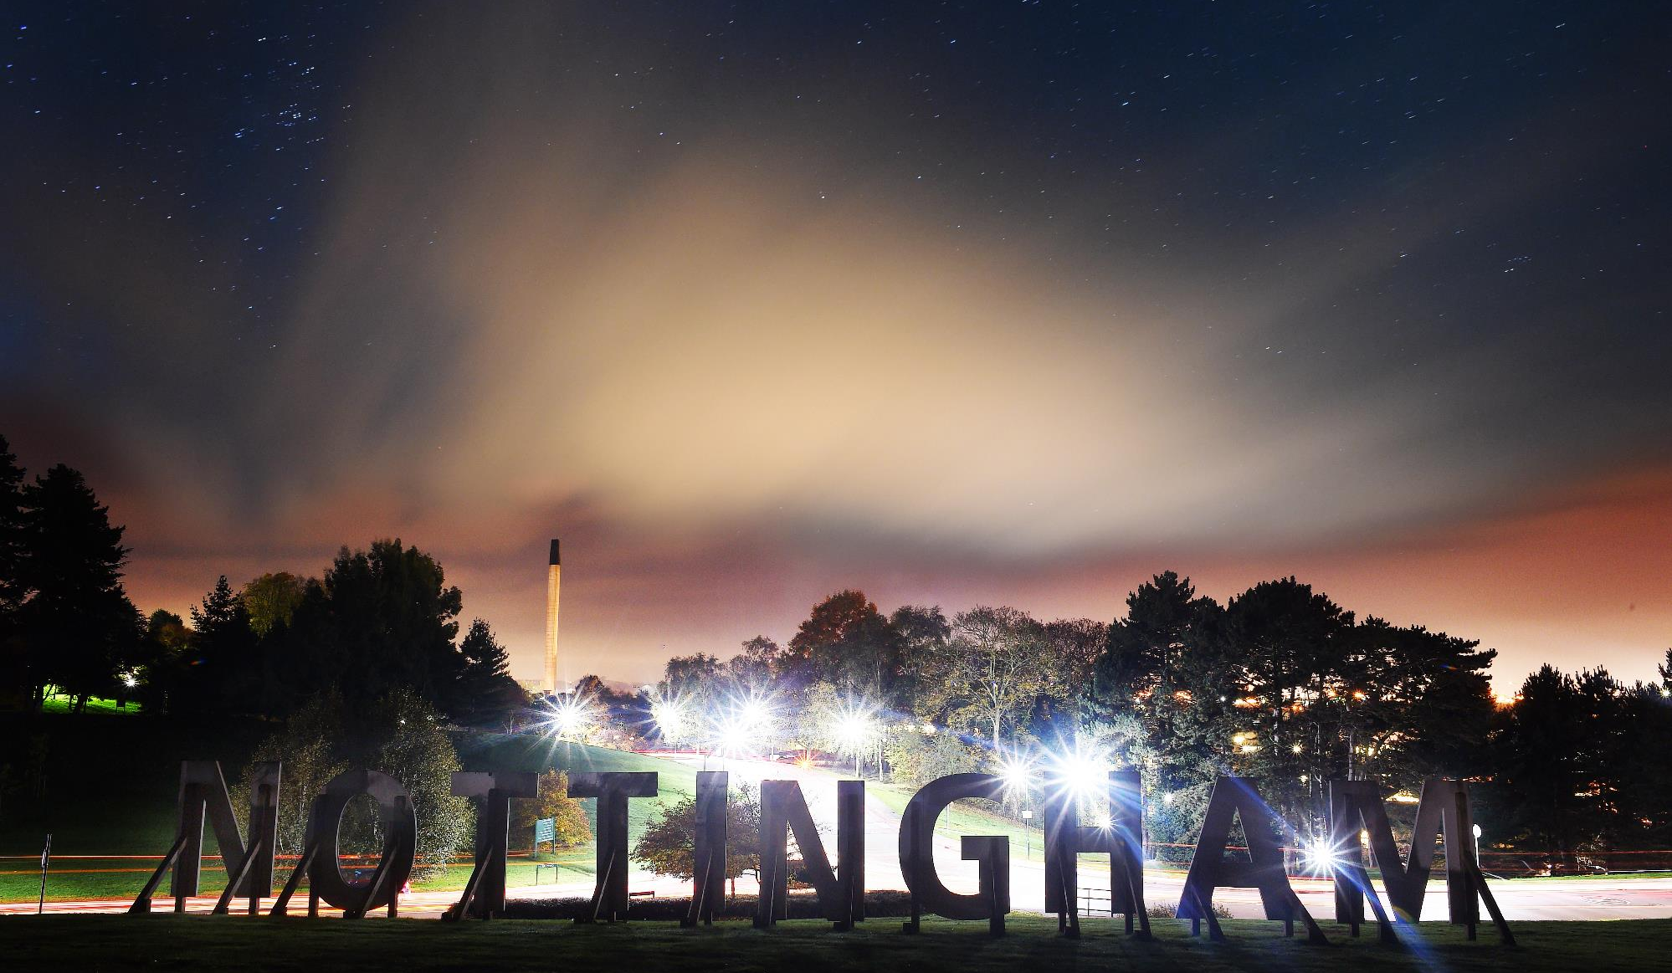
NOTTINGHAM
CONTACT US AT:
MARKETING@MARKETINGNOTTINGHAM.UK

