Slide 1
WORKING IN NOTTINGHAM
A green city with a legendary past, a vibrant culture and a bright future.
A creative city of rebels and pioneers, and the home of Robin Hood.

Slide 2
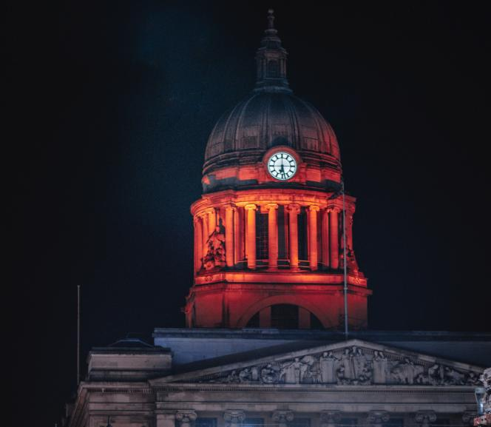
NOTTINGHAM
NOTTINGHAM is an AMBITIOUS CITY with a STRONG INDEPENDENT SPIRIT, a city that isn’t afraid to DISRUPT THE STATUS QUO and do things differently, the perfect place to GROW A BUSINESS.
NOTTINGHAM
Nottingham Council House

Slide 3
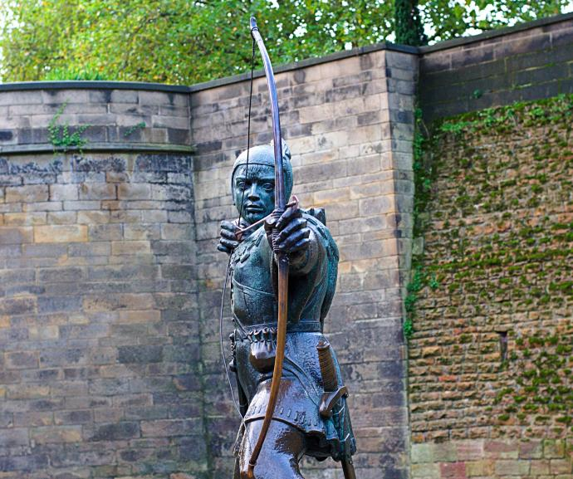
NOTTINGHAM
A city of LEADERS AND LEGACY, known for its RESILIENCE, its COMPASSION and its COMMUNITY SPIRIT – just like ROBIN HOOD.
NOTTINGHAM
Robin Hood Statue

Slide 4
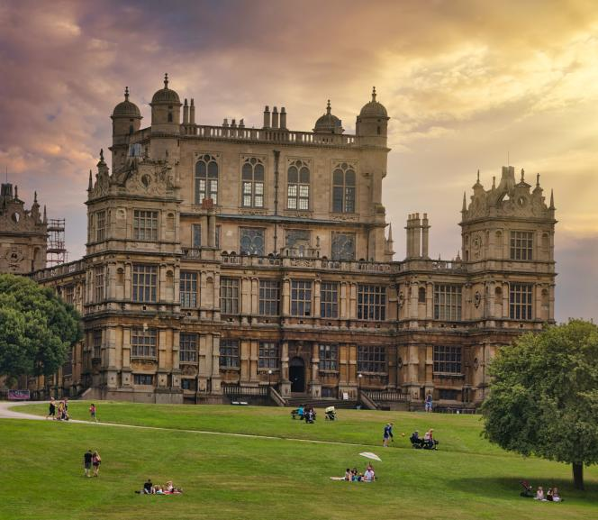
NOTTINGHAM
A city that’s LEADING THE FIGHT AGAINST CLIMATE CHANGE, with the awards and accolades to prove it.
NOTTINGHAM
Wollaton Hall

Slide 5
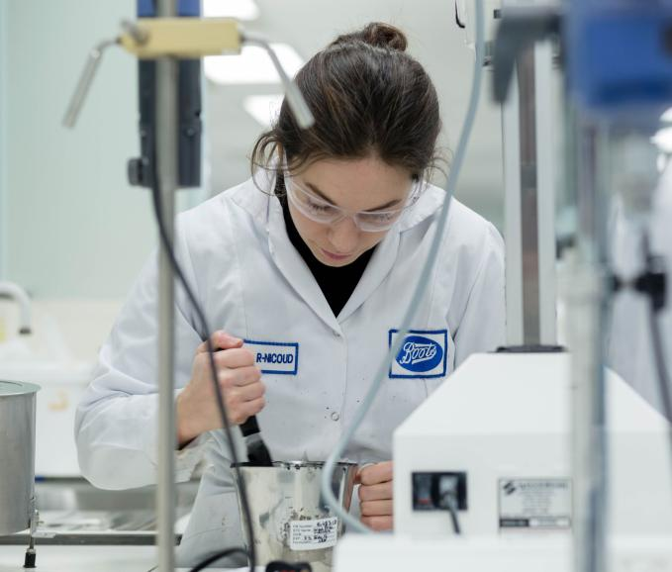
Boots Nottingham
Credit Marketing Nottingham
NOTTINGHAM
The BIGGEST BUSINESS CENTRE in the East Midlands, it’s home to GLOBAL names including BOOTS, CAPITAL ONE and EXPERIAN.
NOTTINGHAM

Slide 6
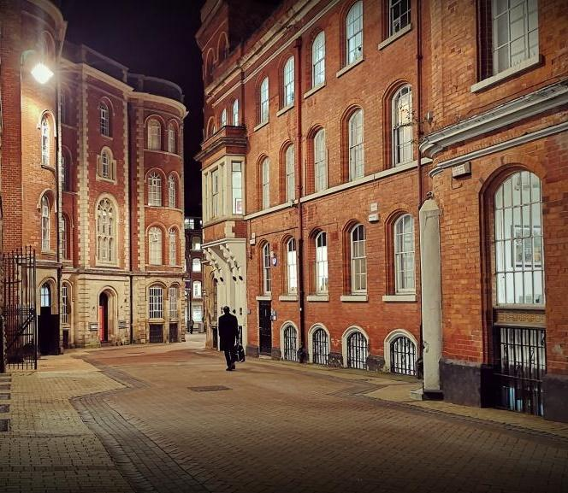
NOTTINGHAM
A city of EMPLOYMENT, EDUCATION and OPPORTUNITY, where PROGRESSIVE MINDS and CREATIVE THINKERS can fulfil their potential.
NOTTINGHAM
Broadway, Lace Market

Slide 7
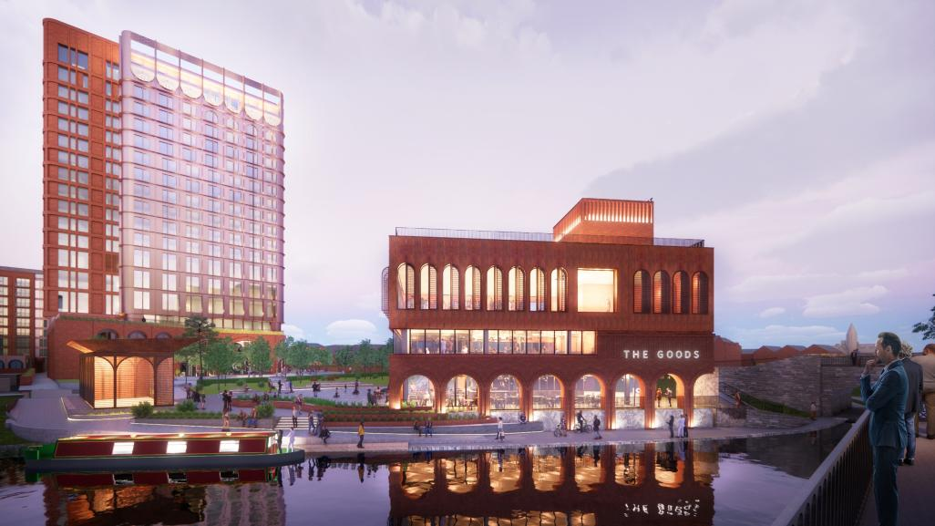
Where START-UPS THRIVE in the REFURBISHED LACE FACTORIES of the CREATIVE QUARTER, a stone’s throw from state of-the-art developments emerging in SOUTHSIDE, WATERSIDE and the ISLAND QUARTER.
NOTTINGHAM
NOTTINGHAM
The Island Quarter
Credit: Jestico + Whiles

Slide 8
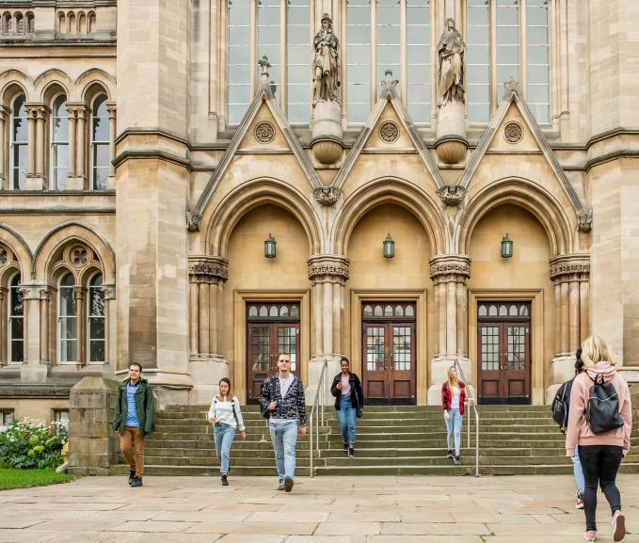
NOTTINGHAM
Where both of our WORLD-CLASS UNIVERSITIES are global leaders in SUSTAINABILITY, nurturing INNOVATION and TALENT to support our strong growing industries particularly DIGITAL TECHNOLOGIES with strengths in FINTECH, CREATIVE, DIGITAL and LIFE SCIENCES which continue to raise our city’s profile.
NOTTINGHAM
Arkwright Building
Nottingham Trent University

Slide 9
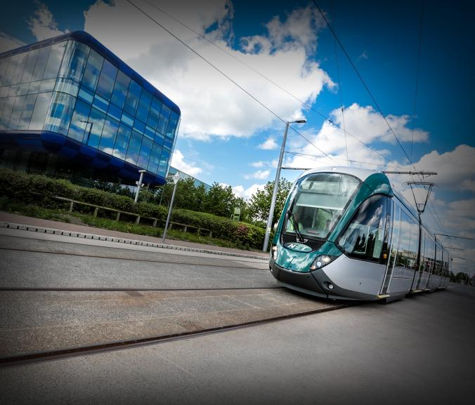
NOTTINGHAM
Where everyone is CONNECTED through a COLLABORATIVE business culture and an AWARD-WINNING, CLEAN AND GREEN public transport system, and where businesses can capitalise on the opportunities in both UK and global markets.
NOTTINGHAM
Nottingham’s award-winning tram system

Slide 10
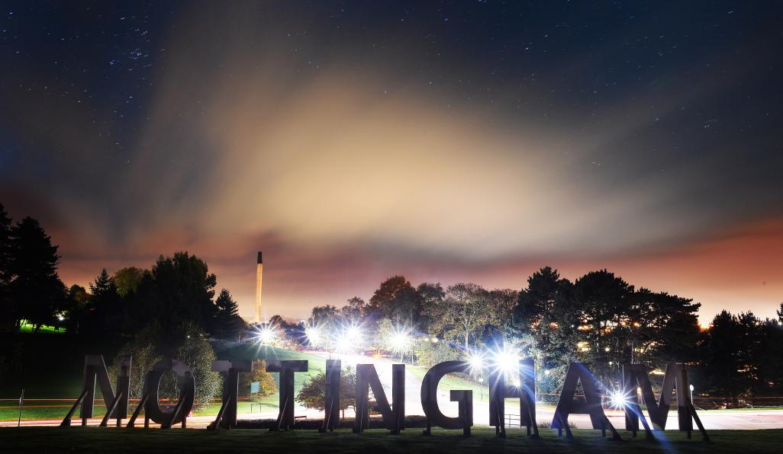
It’s a place that’s MOVING FORWARD FAST and INVESTING IN ITS FUTURE – driving POSITIVE CHANGE and enterprise for everyone.
NOTTINGHAM
NOTTINGHAM

Slide 11
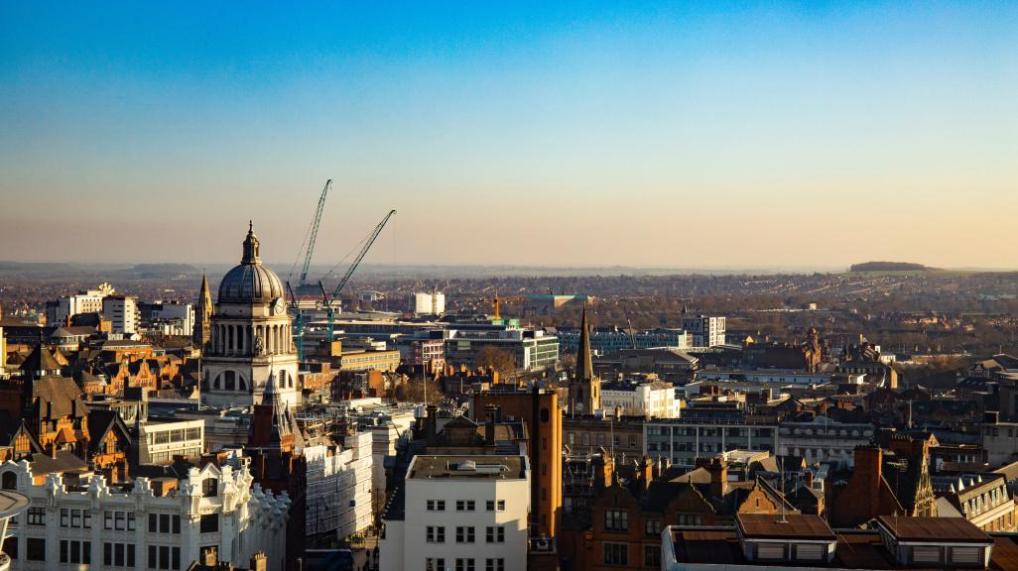
CONTACT US AT:
ENQUIRIES@INVESTINNOTTINGHAM.CO.UK

